Slide 1
Invitation to Quantum Information I
1st eduQUTE school on quantum technologies
Bratislava 19-22/02/2018
Daniel Reitzner
Research Center for Quantum Information, Slovak Academy of Sciences

Slide 2
Welcome notes
Do not hesitate to ask questions anytime during the talk if something will be unclear!
Red bookmarks = general descriptions despite being in sections about particular systems
Should you make notes? The presentation will be published on the web-page The white-board computations may not
Literature
T. Heinosaari, M. Ziman – The Mathematical Language of Quantum Theory: From Uncertainty to Entanglement (Cambridge University Press, 2012)
M.A. Nielsen, I.L. Chuang – Quantum Computation and Quantum Information (Cambridge University Press, 2000)
J. Preskill, Ph219/CS219 course on Quantum Computation [online]

Slide 3
Introduction
Or why are we doing this...

Slide 4
Structure
From bit to qubit
New effects
Helpful effects – superposition and interference
Applications: cryptography, computation
Adding another qubit
EPR paradox, non-locality and entanglement
What is possible and what is not
Applications: superdense coding, quantum teleportation, approximate copying, state discrimination and noisy measurements
Some generalizations
States
Measurements
Evolutions

Slide 5
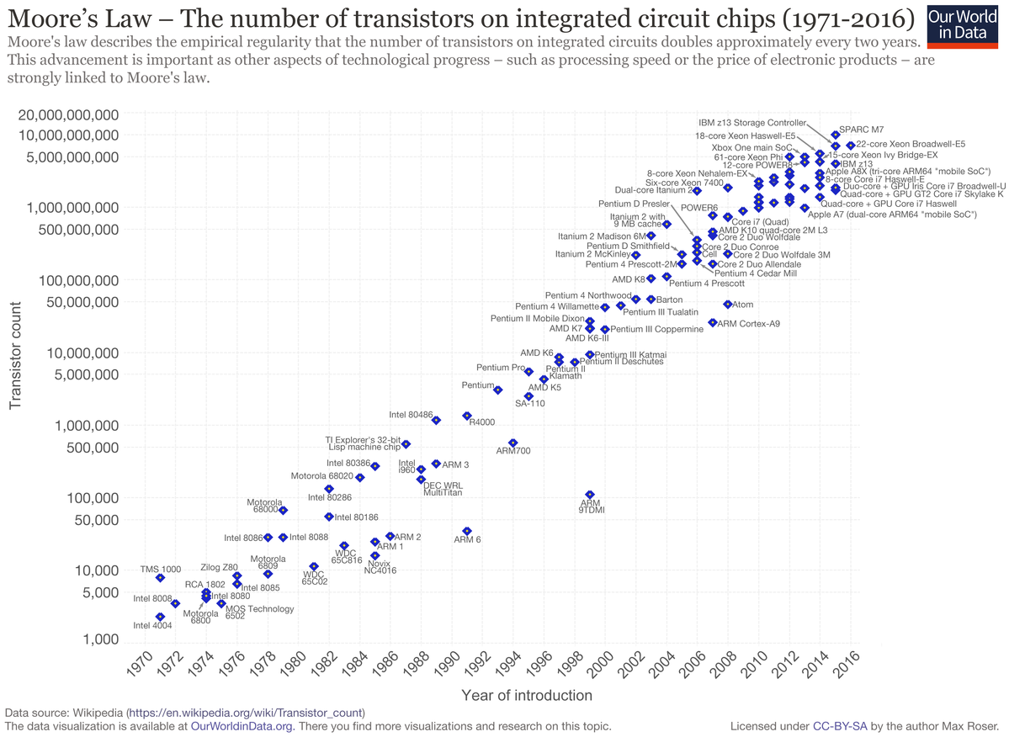
Why QI?
Field of Classical information processing is highly successful
Moore’s law
We are reaching limits posed by quantum world
Designers already have to deal with quantum effects

Slide 6
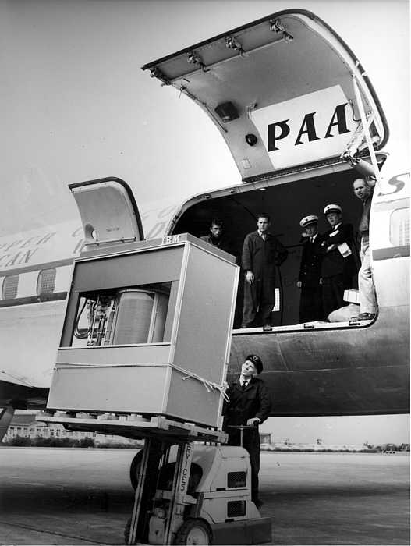
Why QI?
Field of Classical information processing is highly successful
1956
5 MB
> 1 t
2018
512 GB
2 g

Slide 7
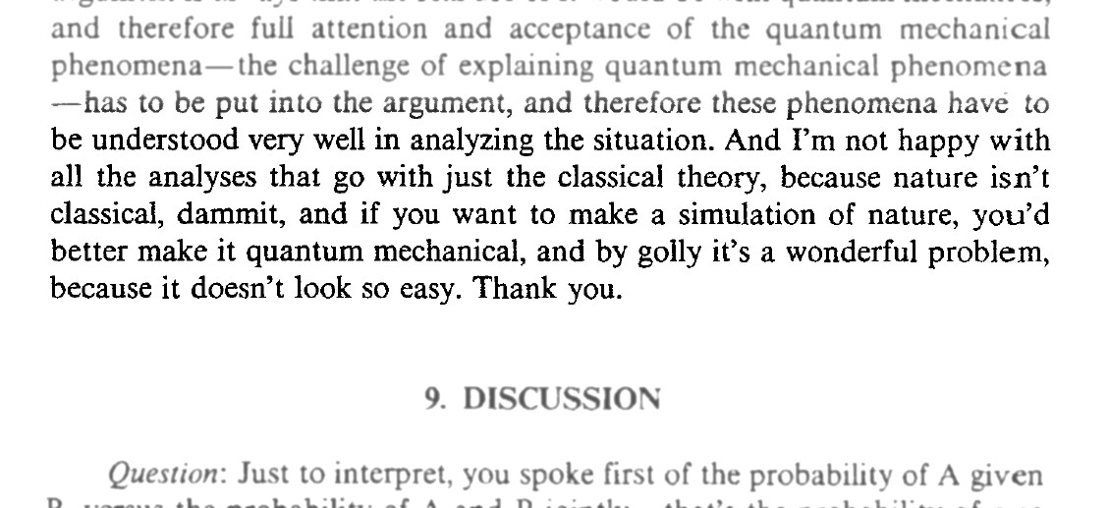
Why QI?
Field of Classical information processing is highly successful
Device independence and universality (NOT + AND)
Basic unit: 1 bit
Classical computation is fast and reliable, though there are difficult tasks that can hinder our progress (material science, medicine) but can also help us (communication and cryptography)
Can quantum mechanics be helpful?
R. Feynman, Int. J. Theoretical Phys., Vol. 21, Nos. 6/7, 1982

Slide 8
One qubit
Is it better than a bit?

Slide 9
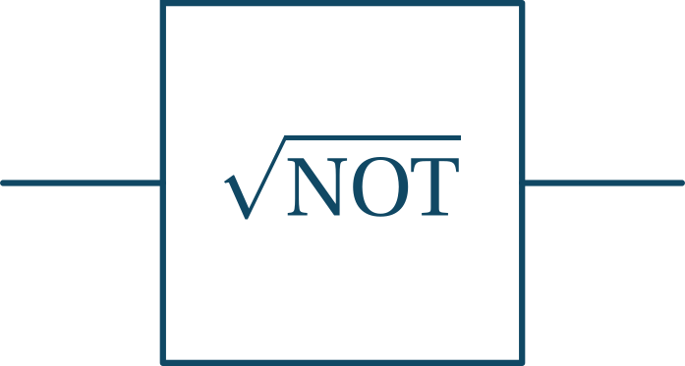
Can you do ?
:
:
Classically clearly impossible. What about probabilistically?
D. Deutsch, A. Ekert, R. Lupacchini - Machines, Logic and Quantum Physics, The Bulletin of Symbolic Logic
Vol. 6, No. 3 (Sep., 2000), pp. 265-283; arXiv:math/9911150 [math.HO]

Slide 10
Can you do probabilistically?
From bit to p-bit: which means that and
Any transformation is a stochastic matrix:
We have and we want such that
Conditions:
We cannot do even probabilistically; now let us look into the quantum case

Slide 11
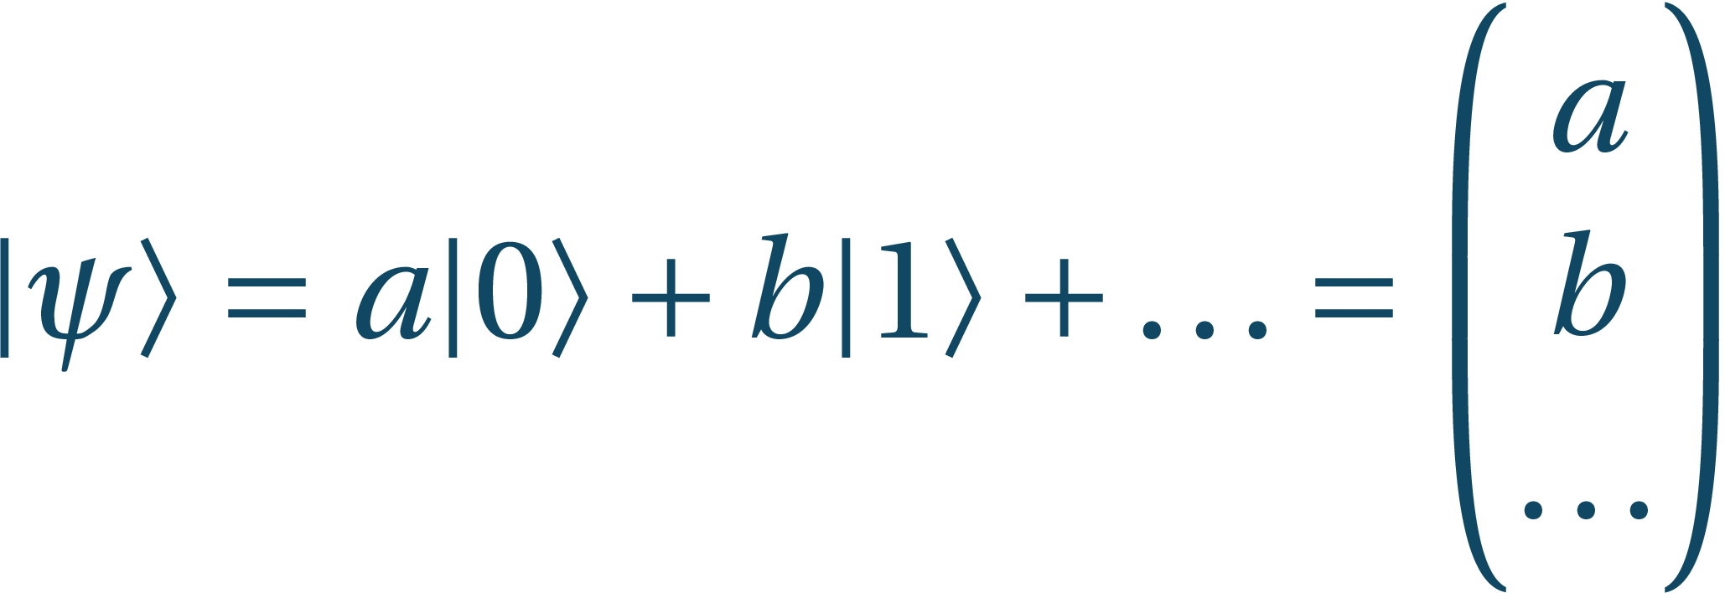
QM refresher - states
State is an element from Hilbert space :
Vector space over ; vectors are
Has an inner product mapping pairs of vectors to :
Positivity: for
Linearity:
Skew symmetry:
Complete in norm
Superposition:
Normalization:

Slide 12
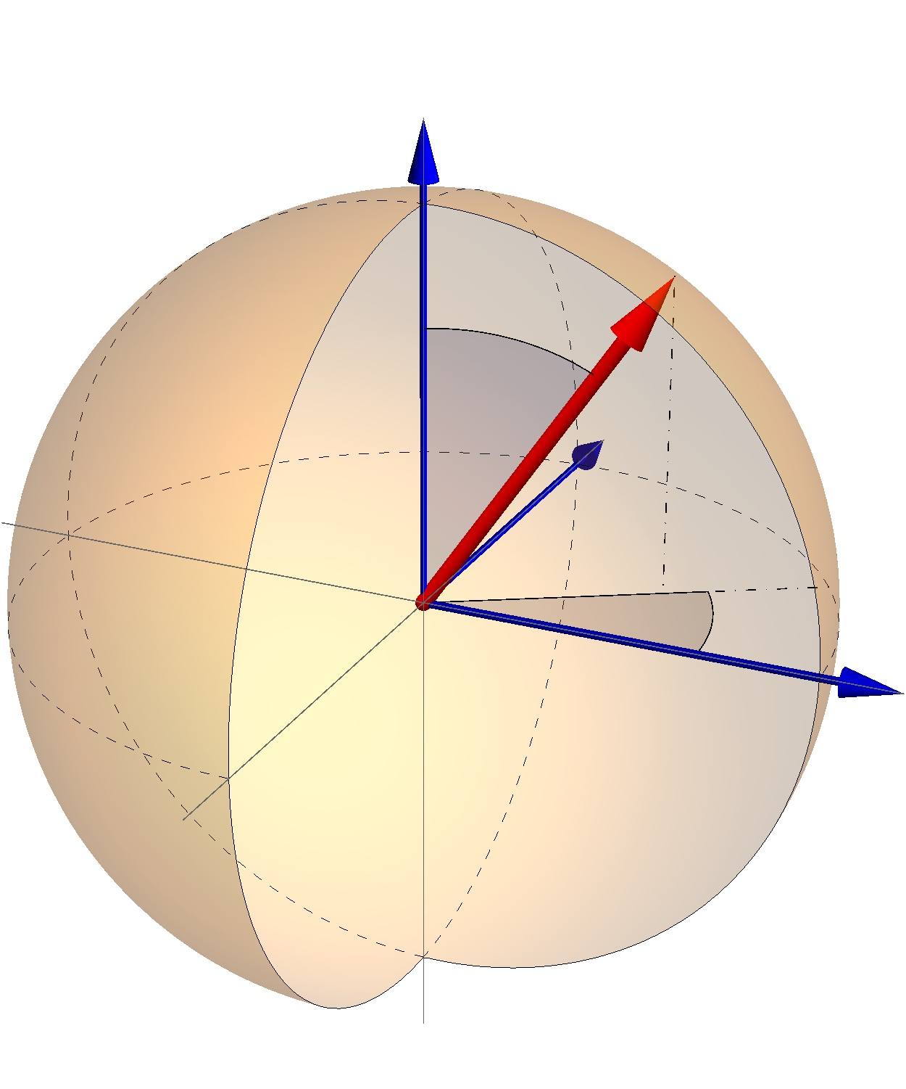
QM refresher – states (QUBITS)
State is an element from Hilbert space:
Orthonormal basis elements:
There are other bases:
Bloch sphere (up to the global phase):
Possible realizations: spin-½ particles, light polarizations, nuclear spins, Josephson junctions, quantum dots, …

Slide 13
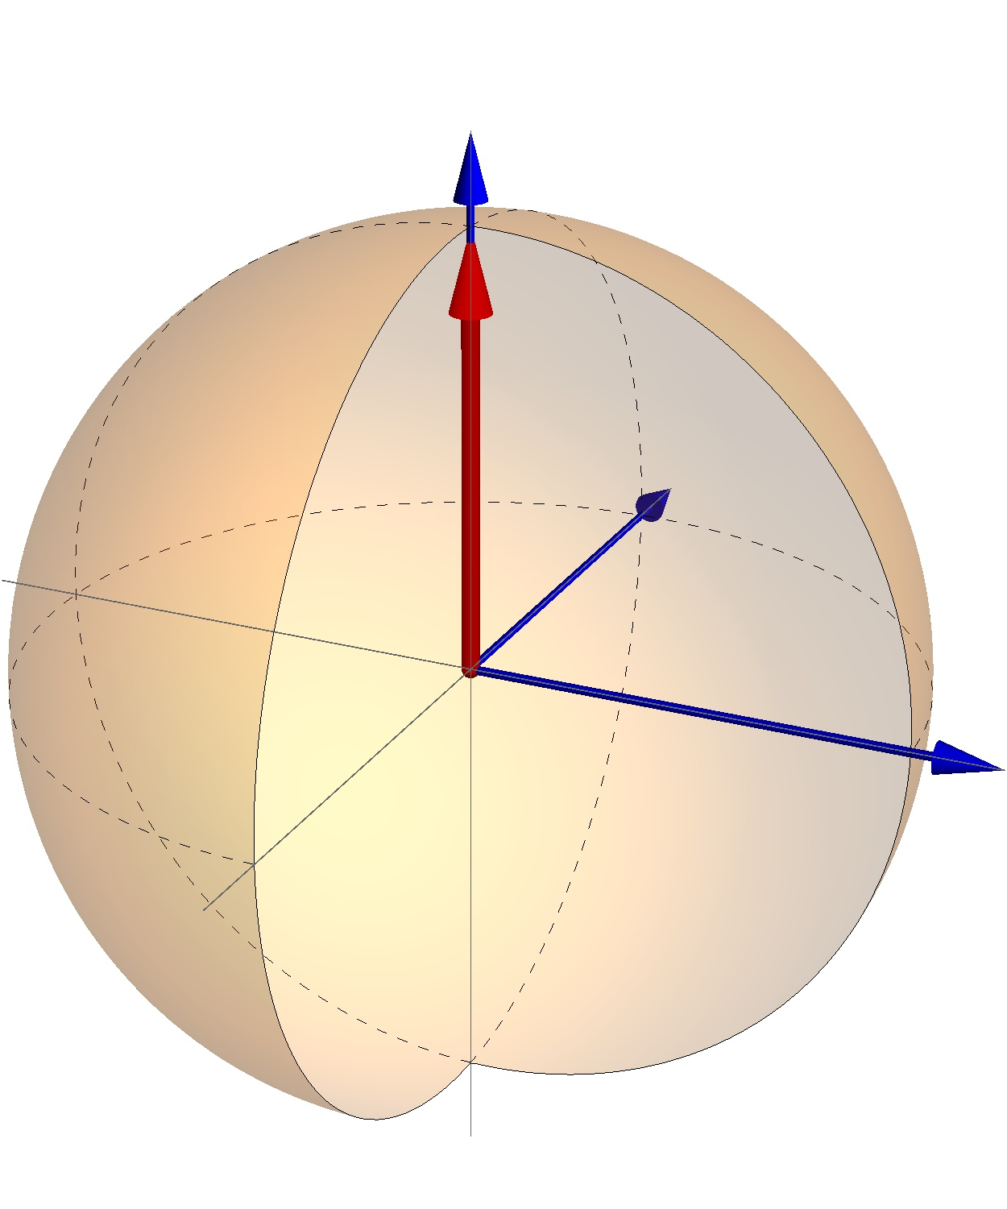
QM refresher – states (QUBITS)
State is an element from Hilbert space:
Orthonormal basis elements:
There are other bases:
Bloch sphere (up to the global phase):
Possible realizations: spin-½ particles, light polarizations, nuclear spins, Josephson junctions, quantum dots, …

Slide 14
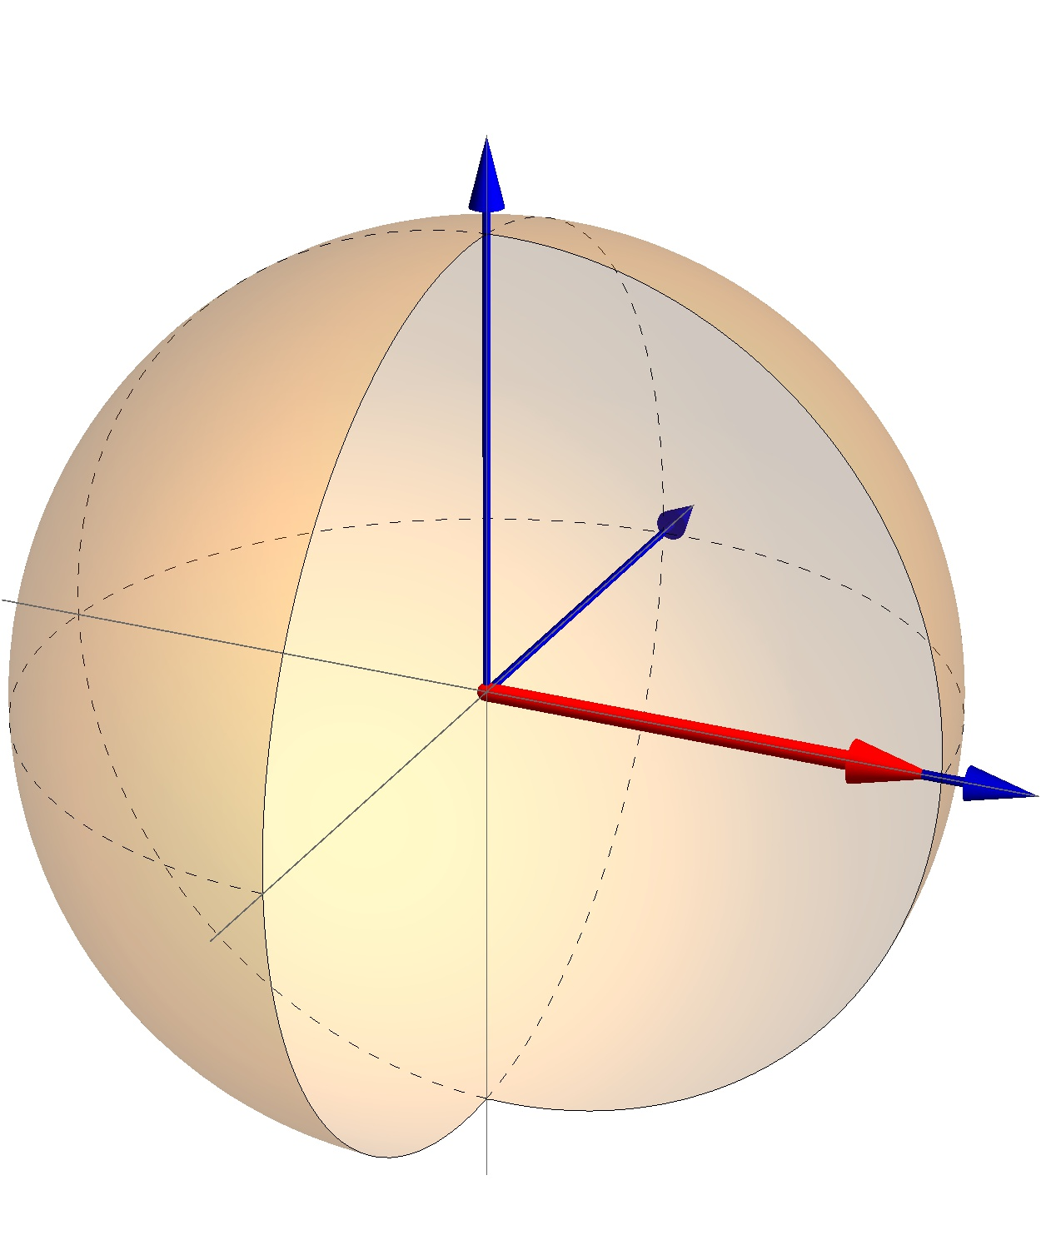
QM refresher – states (QUBITS)
State is an element from Hilbert space:
Orthonormal basis elements:
There are other bases:
Bloch sphere (up to the global phase):
Possible realizations: spin-½ particles, light polarizations, nuclear spins, Josephson junctions, quantum dots, …

Slide 15
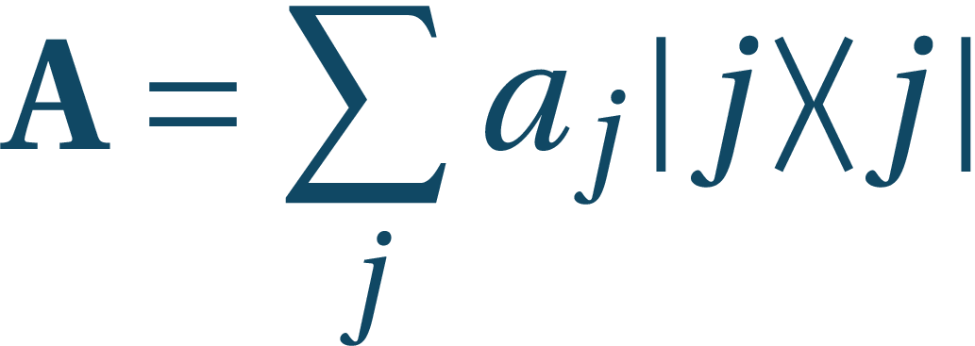
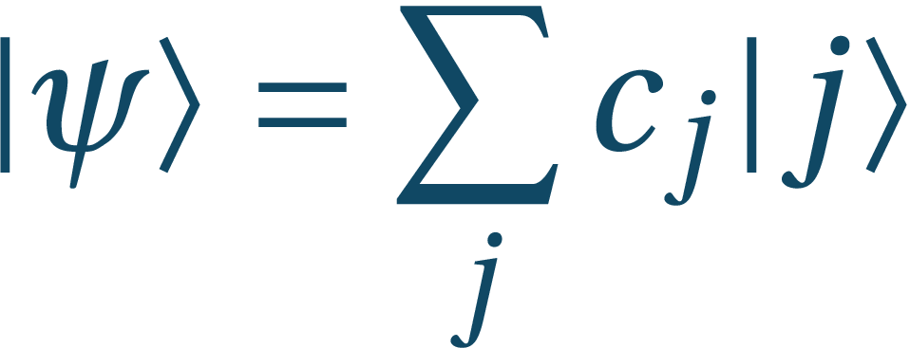
QM refresher - Observables
Observables are self-adjoint operators (matrices) , that map
Having state , the average value is given by:
Observable has a decomposition: ,
State can be also written in this basis:
Measurement in this basis gives result j with probability
State after measurement:
States unique up to global phase: (states are equivalent classes – rays) Unitaries as well

Slide 16
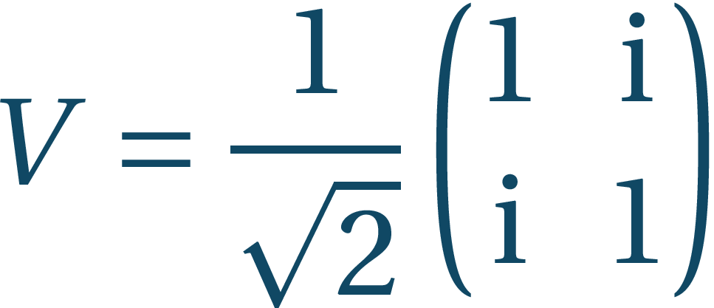
QM refresher - evolutions
Changes to systems are described similarly as in the probabilistic case:
Here U is a unitary operator (matrix), i.e.
Unitarity conserves normalization and makes computation reversible
So what we want to find is U such that
Let us try:
It is unitary !

Slide 17
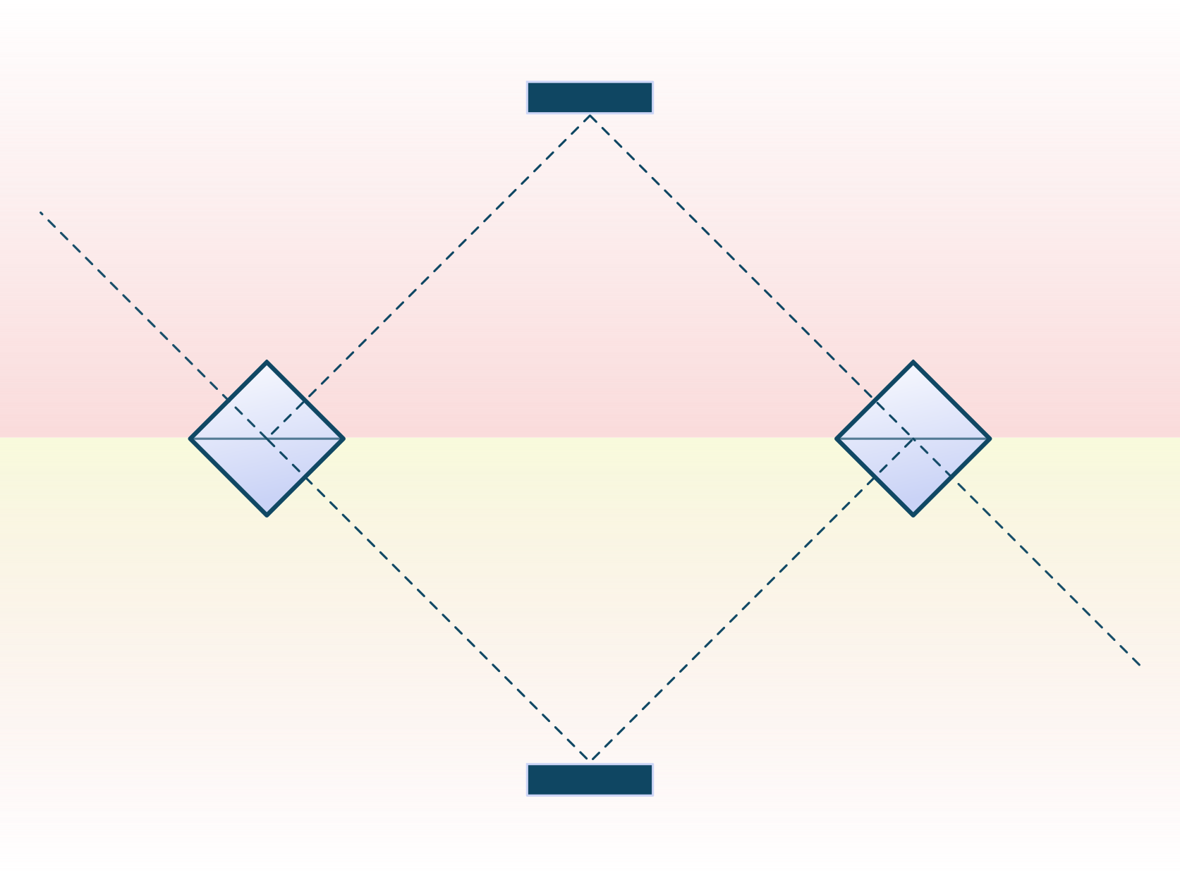
QM refresher - evolutions
This has also a nice physical realization: beamsplitters act as

Slide 18
Summary
In quantum case we can find
Quantum case thus provides us with possibilities beyond classical computation
On one hand quantum computation includes classical computation as a subset:
Measurements in the canonical basis give canonical states with probability 1
Classical gates can be also simulated in quantum scenario
On the other hand... Q: Can we use this additional features in our advantage? A: Yes, it can even save your life…

Slide 19
One qubit
And its power to save your life

Slide 20
Tribe of bored cannibals
Suppose you are on an island awaiting to be a tasty meal for the tribe. The chief, not having much to do recently, offers you a way out of this pickle. He will play a game with you. In the morning he picks one of the four magic boxes: Sadly, they look all the same. He presents it to you and gives you one try with the box. After that, in order to survive, you have to tell him whether it is one of the red ones, or one of the blue ones. Can you survive with certainty?

Slide 21
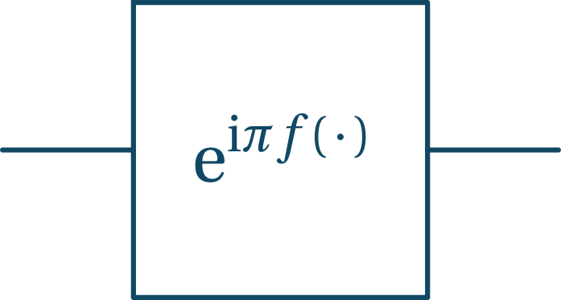
Tribe of bored cannibals
Classically, you are never sure to win. For any box f and any input state, there is a box in the other group that will output the same, so you have no way of telling which group your box belongs to
Now you are clever and can plug the box into your (quantum) device, which produces a new box for
You also luckily have your box with you and you can use following setup to survive:

Slide 22
Tribe of bored cannibals
Let us look at the cases for the setup
Red boxes – balanced functions:

Slide 23
Tribe of bored cannibals
Let us look at the cases for the setup
Red boxes – balanced functions:
Blue boxes – constant functions:

Slide 24
Tribe of bored cannibals
Let us look at the cases for the setup
Red boxes – balanced functions: outputs
Blue boxes – constant functions: outputs
We can survive with certainty (Deutsch-Jozsa algorithm)
David Deutsch, Richard Jozsa. Rapid solutions of problems by quantum computation. Proceedings of the Royal Society of London, Series A, vol. 439, pp. 553, 1992.

Slide 25
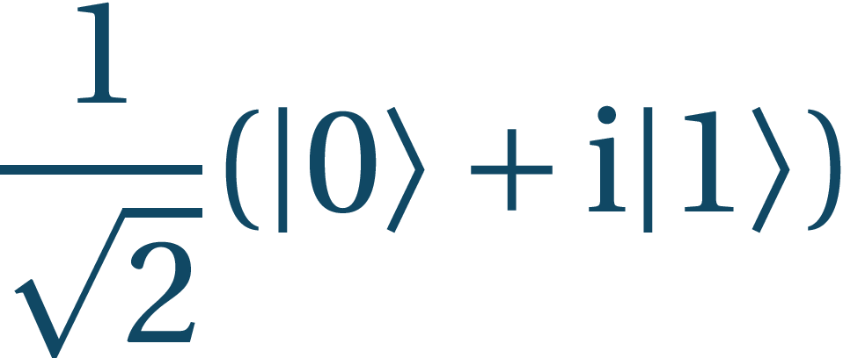
Tribe of bored cannibals
Let us look at it step-wise
What did we use?
Superposition – in general cases we will see that in quantum case we can work on different basis states in parallel
Interference – getting reasonable result is, however, the more difficult part and relies on destructive interference on unwanted results and constructive interference of wanted results

Slide 26
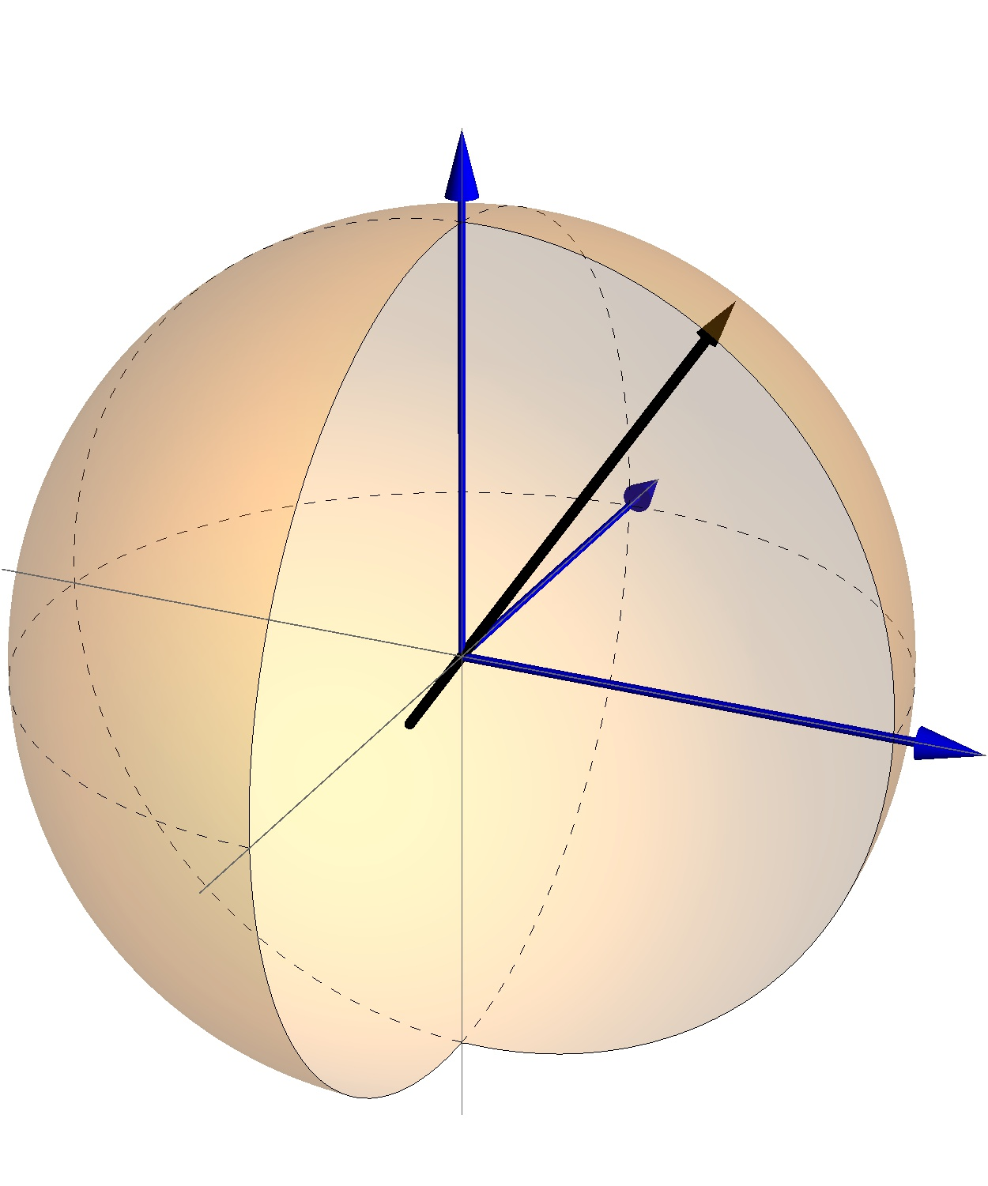
Unitaries and the Bloch sphere
Similarly as states, we can express also unitaries in Bloch representation (up to a phase):
Here represent a unit vector and is a vector of Pauli matrices:

Slide 27
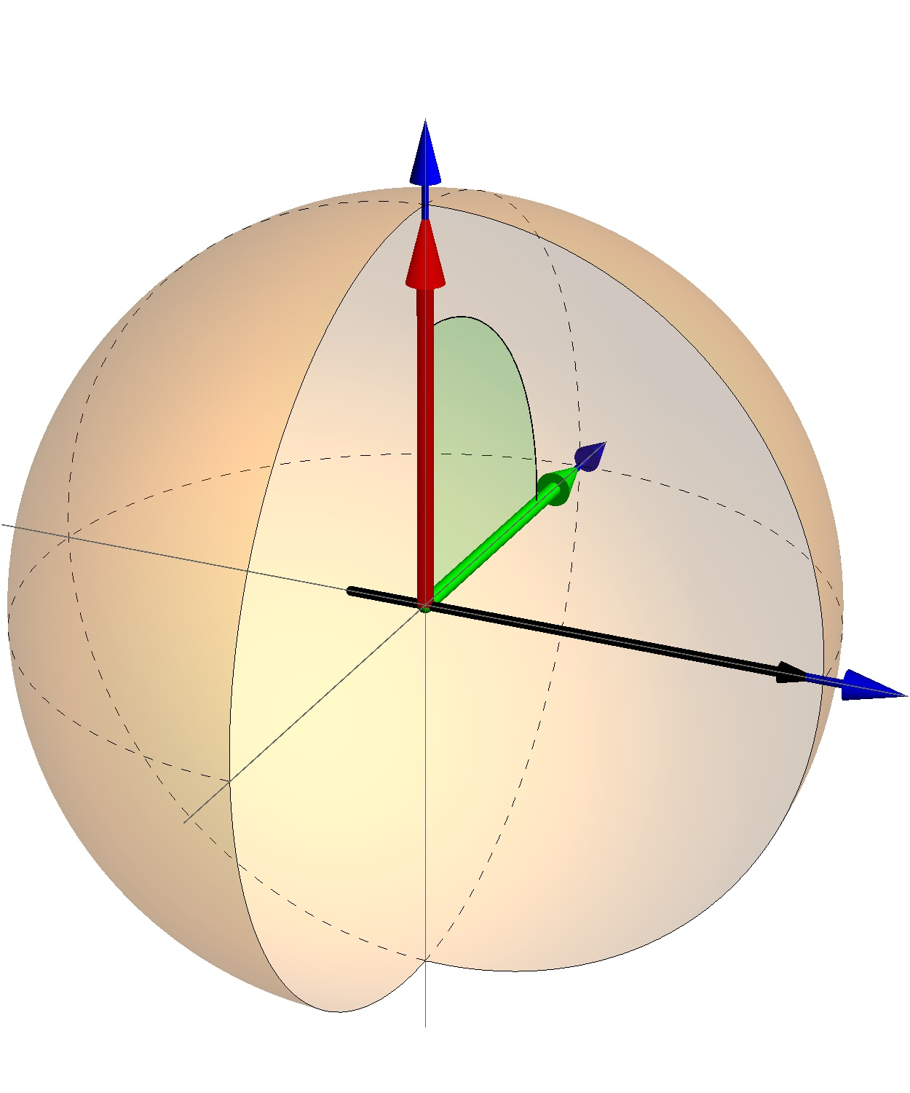
Unitaries and the Bloch sphere
Similarly as states, we can express also unitaries in Bloch representation (up to a phase):
Here represent a unit vector and is a vector of Pauli matrices:
Our square root of not is:

Slide 28
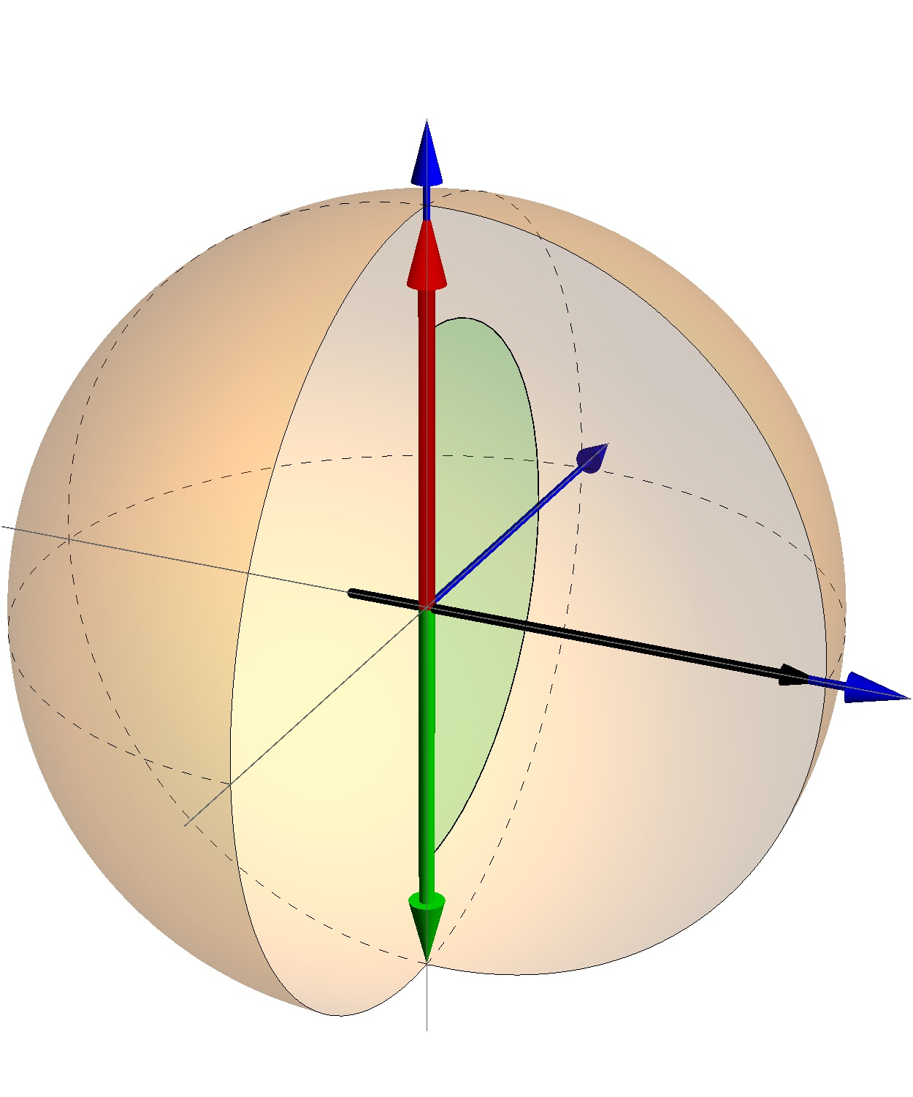
Unitaries and the Bloch sphere
Similarly as states, we can express also unitaries in Bloch representation (up to a phase):
Here represent a unit vector and is a vector of Pauli matrices:
If we apply V twice we get:

Slide 29
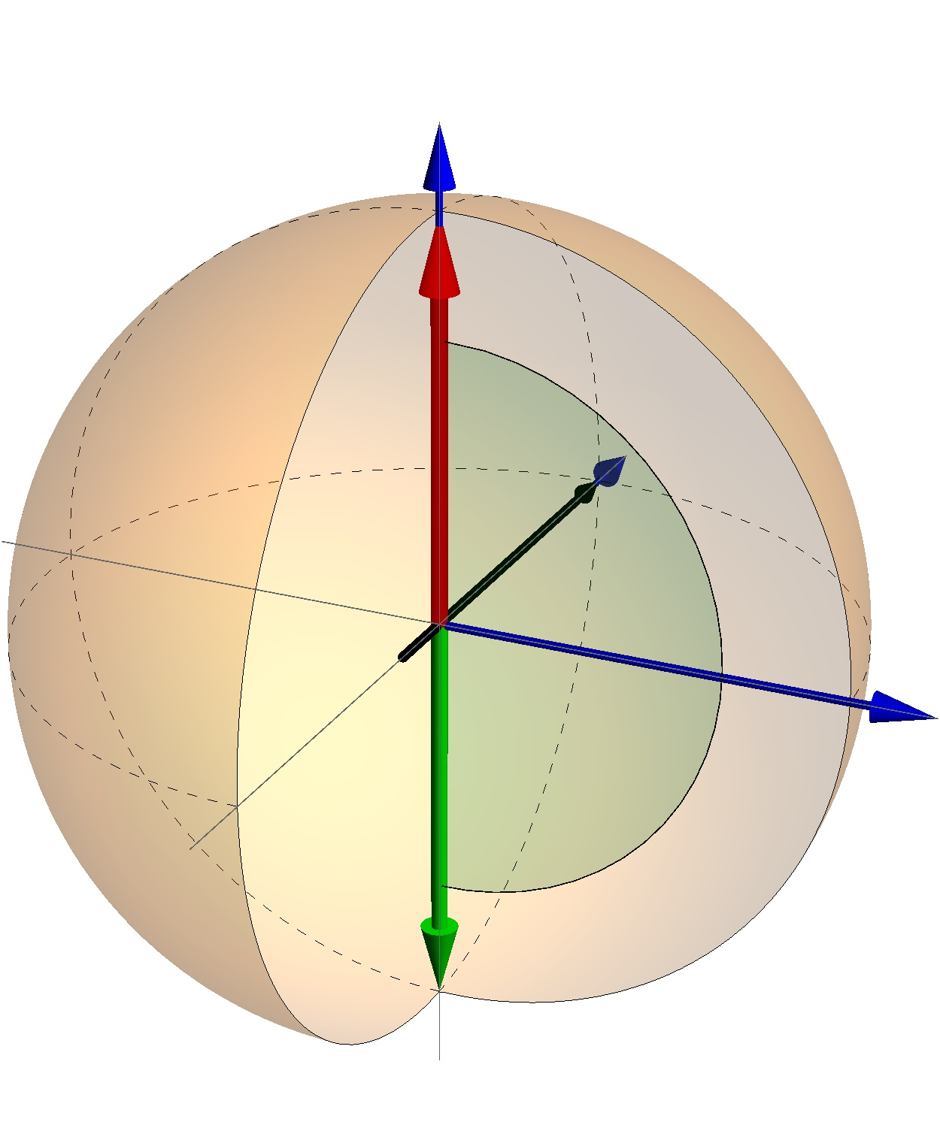
Unitaries and the Bloch sphere
Similarly as states, we can express also unitaries in Bloch representation (up to a phase):
Here represent a unit vector and is a vector of Pauli matrices:
What are and ?

Slide 30
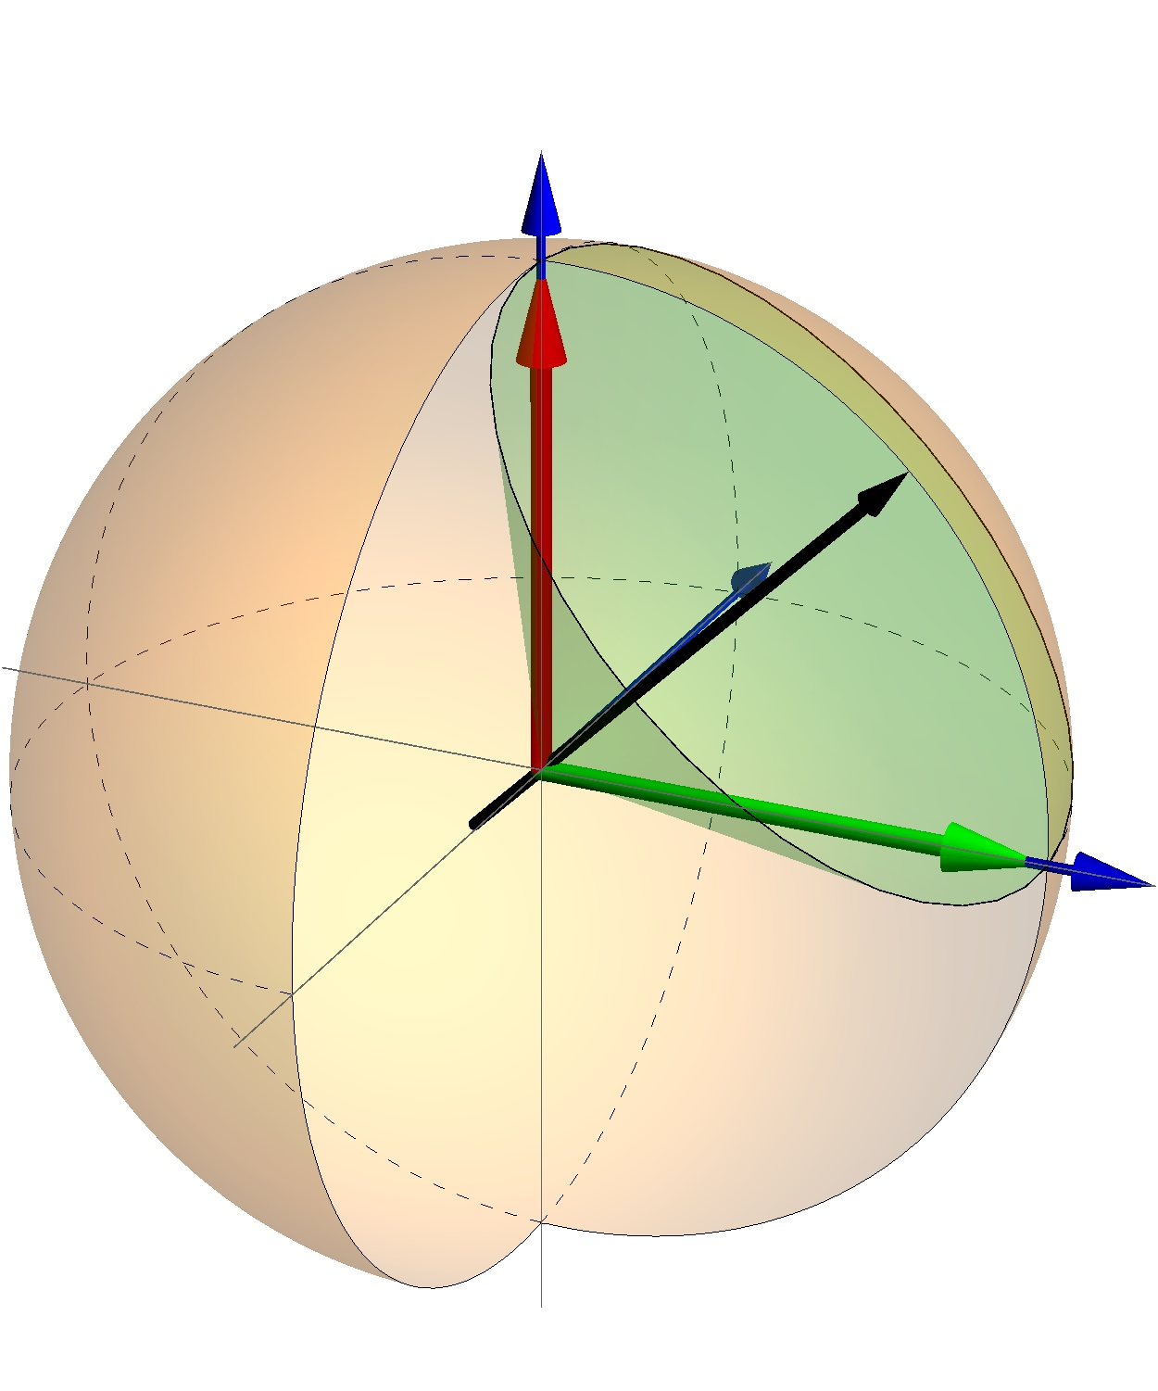
Unitaries and the Bloch sphere
Similarly as states, we can express also unitaries in Bloch representation (up to a phase):
Here represent a unit vector and is a vector of Pauli matrices:
Hadamard matrix:
Every unitary U defines a basis

Slide 31
Summary
Qubit states representable on the Bloch sphere
Unitary operators perform rotation of these vectors (and of whole bases)
Some interesting unitaries
Different realizations of qubit:
Spin-½ particle: for spin up and for spin down
Light polarization: for horizontal polarization and for vertical; diagonal polarization:

Slide 32
ONE qubit
And its practical use (now for real)

Slide 33
A more practical example
Quantum key distribution (QKD)
But first, how can we communicate while keeping our messages secret?
We can use algorithms that encode the message on one side, the message is then sent to the receiver who decodes it:
We want both encoding and decoding to be fast
Without secret key the message needs to be close to impossible to crack
Safest way is to use one-time pad

Slide 34
One-time pad
(C) John Richardson

Slide 35
One-time pad
011010100010101
(C) John Richardson

Slide 36
One-time pad
011010100010101
+ (mod 2)
110100100011010
=
101110000001111
+ (mod 2)
110100100011010
=
011010100010101
(C) John Richardson

Slide 37
One-time pad
011010100010101
011010100010101
(C) John Richardson

Slide 38
One-time pad
110100100011010
110100100011010
110100100011010
(C) John Richardson

Slide 39
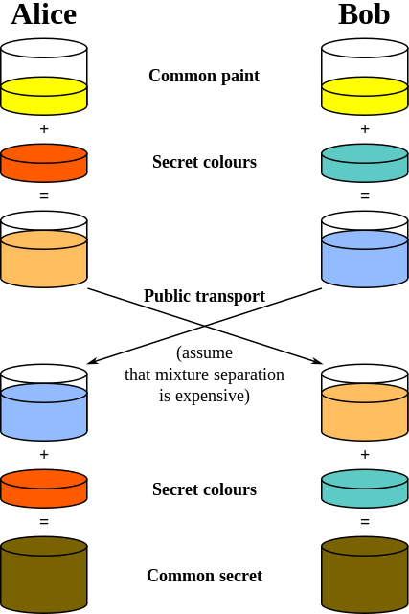
Classical key generation
In order to secure the key distribution, keys are generated on sender’s and receiver’s sites, whereas only information that is difficult to use for an eavesdropper is transferred
This is only conditional security, as we have to believe that the eavesdropper does not have means to use the transmitted information to gain knowledge about the key
Quantum mechanics allows for unconditional security of such key generation

Slide 40
B92 Quantum Key Distribution
Alice wants to generate key with Bob and chooses string of random bits
If her bit is 0, she sends state , if her bit is 1, she sends state
Bob chooses his own string
If his bit is 1, he measures straight away, if his bit is 1 he first applies H to the state and gets results
0111010001010110
0+++0+000+0+0++0
1010110111000010
0+1+00+001-+-+0+
C.H. Bennett - Quantum Cryptography Using Any Two Nonorthogonal States, Phys. Rev. Lett. 68, 3121 (1992)

Slide 41
B92 Quantum Key Distribution
Alice wants to generate key with Bob and chooses string of random bits
If her bit is 0, she sends state , if her bit is 1, she sends state
Bob chooses his own string
If his bit is 1, he measures straight away, if his bit is 1 he first applies H to the state and gets results
Whenever he gets 1 he writes down 1, whenever he gets – he writes down 0
0111010001010110
0+++0+000+0+0++0
1010110111000010
0+1+00+001-+-+0+
1 10 0
C.H. Bennett - Quantum Cryptography Using Any Two Nonorthogonal States, Phys. Rev. Lett. 68, 3121 (1992)

Slide 42
B92 Quantum Key Distribution
Cases are following
Alice
0 | 1/8 | 1/4
 | 1/8 | 0
1 | 1/4 | 1/8
 | 0 | 1/8
Bob

Slide 43
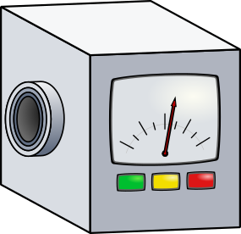
What happens when Eve starts to eavesdrop?
Eve can intercept the transmission, measure the state and based on her result prepare another that she sends to Bob
(C) John Richardson

Slide 44
What happens when Eve starts to eavesdrop?
Eve can intercept the transmission, measure the state and based on her result prepare another that she sends to Bob
(C) John Richardson

Slide 45
What happens when Eve starts to eavesdrop?
Alice
0 | 1/8 | 1/4
 | 1/8 | 0
1 | 1/4 | 1/8
 | 0 | 1/8
Eve

Slide 46
What happens when Eve starts to eavesdrop?
Alice
M
bit
P
Eve

Slide 47
What happens when Eve starts to eavesdrop?
Alice
M
bit |  | - |  |  |  |  |  | -
P |  | - |  |  |  |  |  | -
Eve

Slide 48
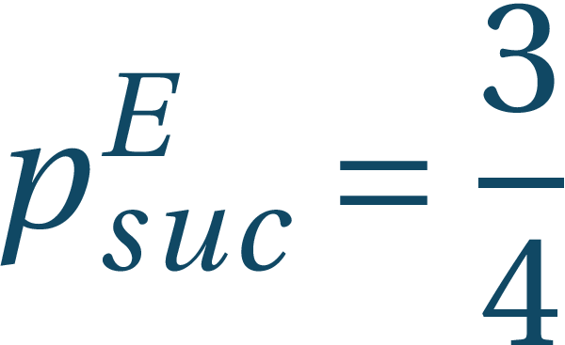
What happens when Eve starts to eavesdrop?
Alice
M
bit | 0 | - | 1 | 0 | 0 | 1 | 1 | -
P |  | - |  |  |  |  |  | -
Eve

Slide 49
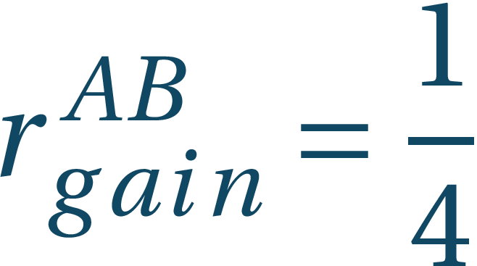
What happens when Eve starts to eavesdrop?
Alice
M
bit | 0 | - | 1 | 0 | 0 | 1 | 1 | -
P |  | - |  |  |  |  |  | -
Eve
 | 1/16 | - | 1/16 | 1/32 | 1/32 | 1/16 | 1/8 | -
 | 1/16 | - | 0 | 1/32 | 1/32 | 0 | 0 | -
 | 1/8 | - | 1/32 | 1/16 | 1/16 | 1/32 | 1/16 | -
 | 0 | - | 1/32 | 0 | 0 | 1/32 | 1/16 | -
Bob

Slide 50
What happens when Eve starts to eavesdrop?
Alice
M
bit | 0 | - | 1 | 0 | 0 | 1 | 1 | -
P |  | - |  |  |  |  |  | -
Eve
 | 1/16 | - | 1/16 | 1/32 | 1/32 | 1/16 | 1/8 | -
 | 1/16 | - | 0 | 1/32 | 1/32 | 0 | 0 | -
 | 1/8 | - | 1/32 | 1/16 | 1/16 | 1/32 | 1/16 | -
 | 0 | - | 1/32 | 0 | 0 | 1/32 | 1/16 | -
Bob

Slide 51
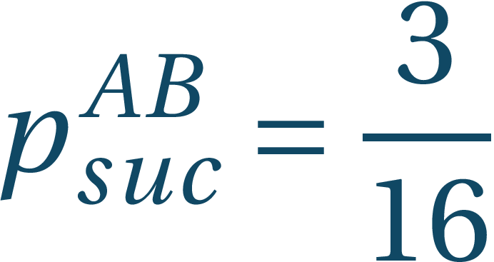
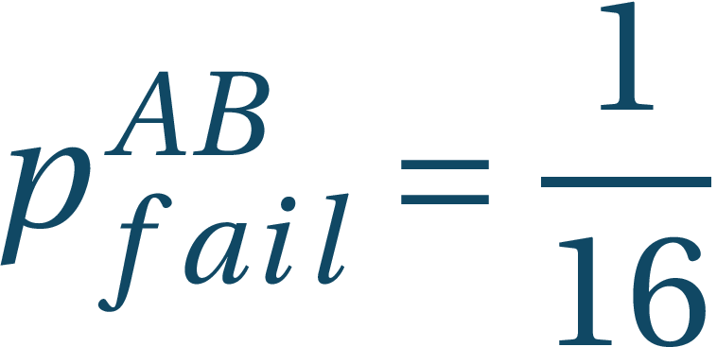
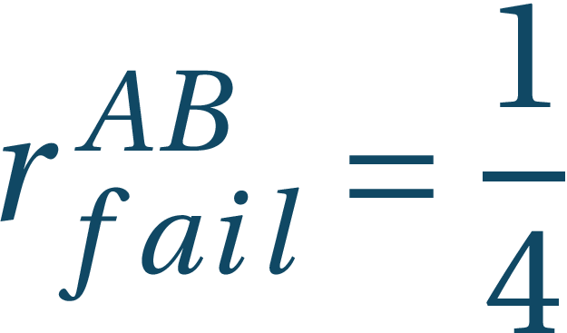
What happens when Eve starts to eavesdrop?
Alice
M
bit | 0 | - | 1 | 0 | 0 | 1 | 1 | -
P |  | - |  |  |  |  |  | -
Eve
 | 1/16 | - | 1/16 | 1/32 | 1/32 | 1/16 | 1/8 | -
 | 1/16 | - | 0 | 1/32 | 1/32 | 0 | 0 | -
 | 1/8 | - | 1/32 | 1/16 | 1/16 | 1/32 | 1/16 | -
 | 0 | - | 1/32 | 0 | 0 | 1/32 | 1/16 | -
Bob

Slide 52
B92 Quantum Key Distribution
Allows secure key generation based on QM
Eavesdropping efficiently detectable
This setup is rather fragile
There are different quantum cryptographic protocols using different resources and allowing different strengths of control and tampering detection
QM can help us crack current cryptographic protocols but on the other hand offers us novel cryptographic procedures

